Slide 1
2010 ECE CAPSTONE Portland State Aerospace Society Portland State University
Team Member:
Pierre Djinki Varun Arur Takuya Namuro
Academic Advisor: Dr. Tymerski
PSAS Advisor: Andrew Greenberg
Sponsor: Portland State Aerospace Society

Slide 3
LV2 FLIGHT COMPUTER CARRIER BOARD
What’s a flight computer ?
The flight computer is the central computer that controls the rocket. It’s a single board computer (SBC)
The Flight Computer :
Pros:
The current single board computer (SBC) is a Freescale MPS5200 that runs Linux and communicates to other avionics systems using USB and the Controller Area Network (CAN). It was chosen because it combined a high performance 400 MHz PowerPC core with many peripherals, including 64 MB SDRAM, 32 MB FLASH, USB 1.1, CAN, UARTS, PCI, ATA/IDE, SPI, and more. The SBC uses high density surface mount connectors on the bottom of the board to connect to the rest of the system.

Slide 4
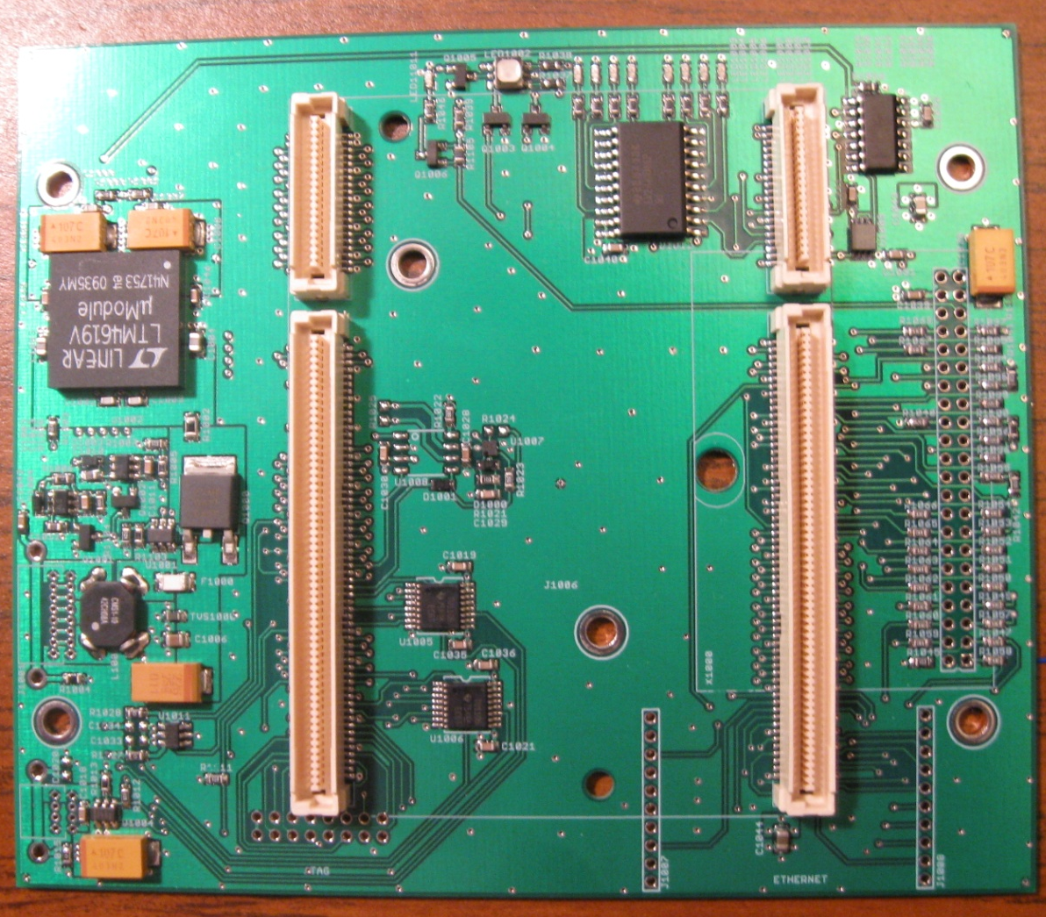
The Flight Computer (Cont…) :
Cons: While a commercial "motherboard" is available to mount the SBC on, it is too large and fragile to use in the rocket.

Slide 5
Design objectives:
Our project is to design, build and test a small, robust carrier board for the current Single Board Carrier, the TQ Inc. TQM5200 SBC

Slide 6
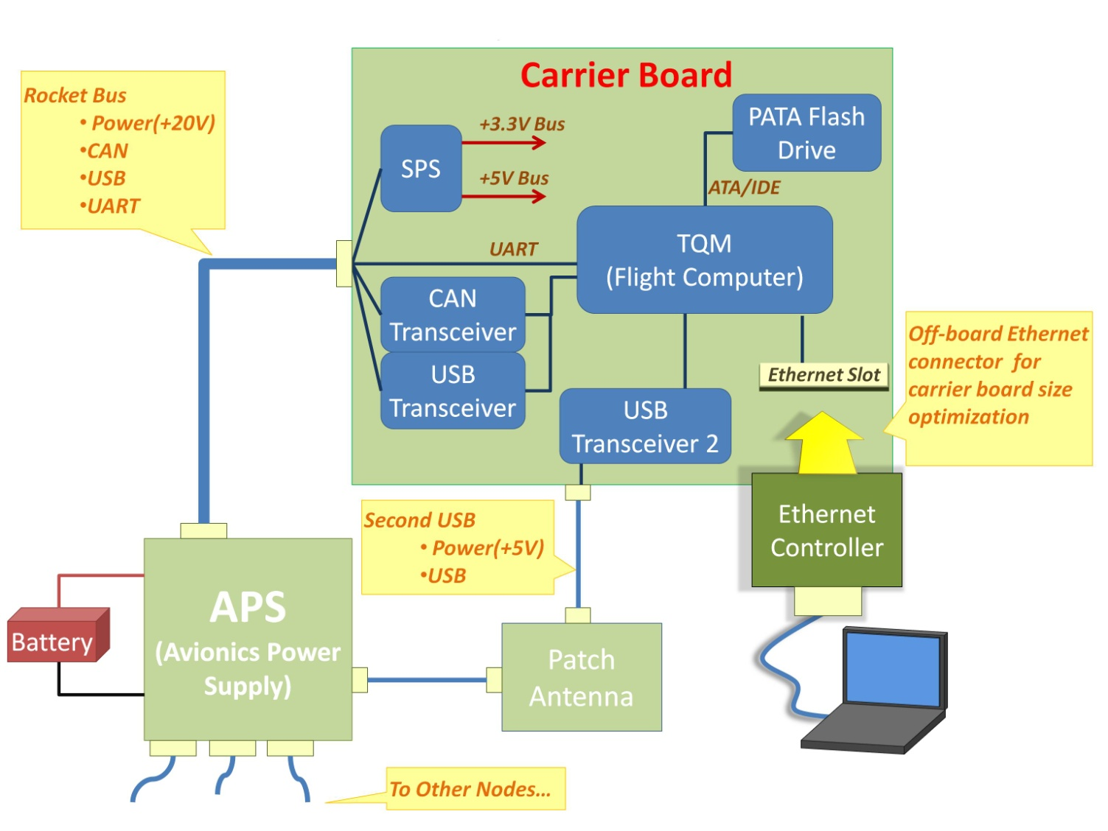
LV2 Block Diagram

Slide 7
Design Requirements:
Functionality , performance ,reliability, cost and size :
Telemetry connector:
Must provide a secondary USB 2.0 full speed electrical connection (data and power) to the 802.11a USB adapter
Must be able to turn the USB power on and off from MPC5200
May have some indication of power on/off, data transfer
IDE Connector:
Must securely retain storage card without data loss at (10,20,) g's of force at hundreds of Hz
May have fastener to hold connector to PCB
Must handle (1,8,) GB of storage
Must support the fastest MPC5200 ATA interface, UDMA mode 2 (33 MB/s) Should be easily removable when not in flight mode; Must have a locked down flight mode
Should be as small and lightweight as possible
May give visual indication for power, reads, and write

Slide 8
Design Requirements (Cont…):
Power Supply:
Must take an input voltage of (10,14.7,20) V.
Must provide 3.3V +/- (,1,5)% for the TQM5200 and CF card.
Must provide 5.0V +/- (,5,10)% for the USB 802.11a adapter.
Must provide enough current, by at least a factor of 120%.
3.3V: 2.2 A * 120% = 2.64A so (2.64,3,) A.
5.0V: 500mA as per USB 2.0 specification so (0.5,1,) A.
Must have a small footprint <= 9 cm&2.
Must be thin, <= 1 cm.
Must be light weight
Must be able to survive (10,20,) g load.
Must be > 70% efficient under all operating loads.
Should have undervoltage cutoff and overcurrent cutoff (foldback is OK).
May have reverse polarity protection; if not, we'll provide it

Slide 9
Design Requirements (Cont…):
Other features:
Must have transceivers as required: CAN, Ethernet, etc.
Must have ESD suppression on all non-power pins.
Should provide 3.3V primary lithium battery for MPC5200 RTC.
Should have at least 8 LEDs and one RGB LED to indication rocket status.
Should have all GPIO available for use via a breakout connector.
If there's an audio out: Should have a small speaker for generating low quality (< 10 KHz BW) tones/voice.
Should breakout VGA, I2C, JTAG and SPI to breakout connectors (VGA needs a corresponding breakout connector to VGA cable).
May have an Ethernet breakout connector (and a corresponding breakout connector to Ethernet cable).Ethernet breakout should include physical layer chips as necessary (e.g., magnetic)
Cost:
Should cost (,150,500) $
Should be a (2,4)layer PCB
Size:
Must be fit in the rocket (ID of ~ 13.33 cm)Must have a width of < 10.6 cm
Should be as small as possible, (48,100,150) cm^2
Should have components on both sides of PCB

Slide 10
Team member Responsibilities:
Pierre: USB interface
CAN interface
Ethernet Connector
IDE Connector
Takuya: Switching Power Supply
Varun: TQM5200
Layout board

Slide 11
USB Interface:
Two USB 1.1 full speed interfaces are used by the FC to communicate high speed data with the rest of the rocket. One USB interface is attached to the rocket's 802.11a-based amateur radio telemetry system, and the other interface attaches to the rest of the avionics system which includes such sensors as a six degree of freedom Inertial Measurement Unit, a GPS receiver, a smart battery pack.
Components:
2 Texas Instrument TUSB1106PWR USB transceiver
Availability on Digikey at about $8.93 a piece
Unambiguous implementation (no additonal
configuration needed for differential mode
data transfer.)
Supports USB 2.0 protocol
relatively small size: 16-TSSOP
Operate with a 5V or 3.3V supply (internal regulator)
1 Texas Instrument TPS2552 Adjustable Current-Limited Power-Distribution Switch
Availability on Digikey at $9.98 a piece
Come in small size package: SOT-23-6
Voltage operation: 2.5 ~ 6.5 V
Programmable current threshold for over current protection set by Rilim
Reverse voltage protection(turn off n-channel mosfet when Vout>135mV)
Fault response asserted during overcurrent, overtemperature

Slide 12
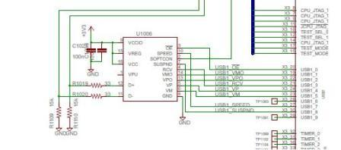
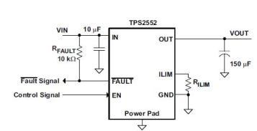
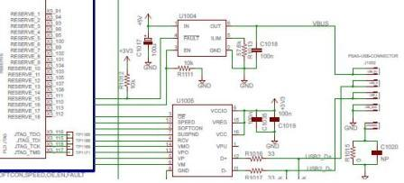
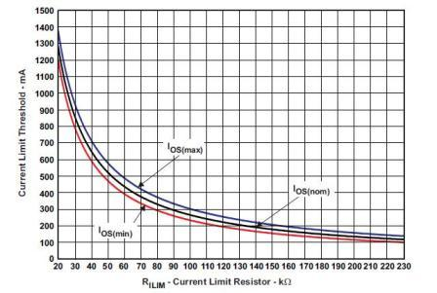
USB Interface (Cont…):
Schematics

Slide 13
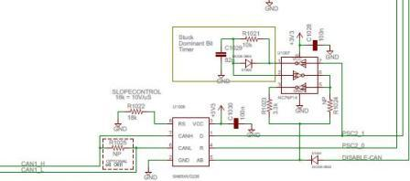
CAN interface:
The Controller Area Network (CAN) is used to meet the need for a highly reliable safety system and communication bus between the nodes of the avionics system. The peer to peer bus topology of CANs is useful in case of a flight computer failure
Components:
1 Texas Instruments CAN transceiver (part#: SN65HVD235)
Availability on Digikey at $4.34
Small size package: SIOC
Voltage operation: 3-3.6V
Because CAN interface was successfully used in prior
Capstone, the sponsor recommended us to use the already
available design.

Slide 14
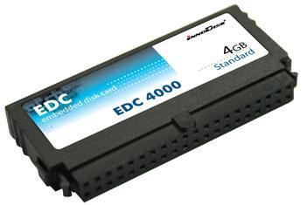
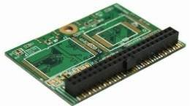
IDE connector:
A 44 pin IDE Flash Module provides a reliable storage device that meets the challenges of a hostile environment, limited space, and low weight. It is compatible with Standard IDE ATA interface and supports UDMA data transfer modes
Components:
Disk On Module (DOM):
Interface: 44pin IDE/ATA
IDE Transfer Mode: PIO mode 0-4/UDMA mode 0-4
Vibration: 5G(7~2000Hz)
Shock: 50G/10ms
Read/Write : 80/75Mbs
DC Input Voltage: 3.3V-5V
A 44-Pin embedded disk card:
Locked housing design for stability
Vibration support
Low Power Consumption: 150mA
DC Input Voltage: +3.3V/+5V Single power supply operation
Windows XP embedded and Linux bootable

Slide 15
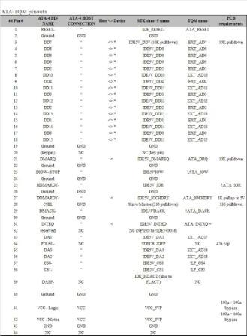
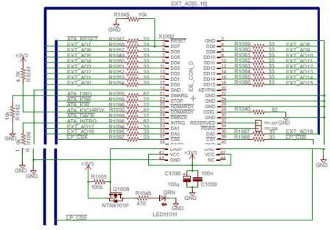
IDE connector (Cont…):
Schematics and table:

Slide 16
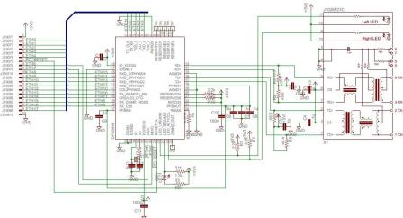
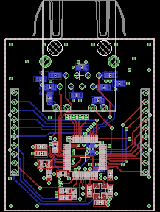
Ethernet Connector:
The Ethernet connection provides a direct, high speed debugging and testing interface. While not used during flight, it is used while developing cod
Components
Ethernet Transceiver
Part #: DP83848C
Unit Price: $6.8 on Digikey
Package: 48-LQFP
DC Input Voltage: 3V~3.6V
RJ45
Part #: J1026F21CNL
Unit Price: $6.59 on Digikey
Package: Panel Mount; Through Hole, R. Angle
Speed: 10/100 Base-TX
LED Color: Yellow - Green
Crystal Oscillator
Part #: ECS-250-20-33-TR
Unit Price: $3.57 on Digikey
Frequency: 25Mhz
Mounting Type: Surface mount

Slide 17
Switching Power Supply:
The Switching power supply (SPS) module takes 20V input from the rocket's power distribution bus and converts to 3.3V and 5V in order to run all of the components on the FC carrier. The SPS node is synchronized with a 500kHz crystal-controlled clock for noise shaping. The SPS includes active protection circuitry with automatic recovery capability from hazardous conditions such as over-voltage, under-voltage, reverse voltage, and even SPS failure (passing unregulated voltage through
Components:
LTM4619 (Dual, 26VIN, 4A DC/DC μModule Regulator):
This is SPS which creates 5V and 3.3V output from 10-20V input. This component was chosen because of high current output (4A) and simplicity of design. It has inductors in the module thus we do not need to design whole buck converter. SPS is synchronized with external clock of 500kHz from the 24MHz oscillator on TQM5200. 24MHz signal is divided down to 500kHz through U1009 and U1010. Its’ input current and output voltage is protected by Q1000. 500kHz of external was chosen because it is easier to be generated from 24MHz oscillator using frequency divider.
MAX5902AAETT (+72V SOT23 Simple Swapper Hot-Swap Controller):
This hot-swap controller IC serves two purposes: (1) circuit-breaker and (2) UVLO protection. This controller turns off Q1000 under several conditions. (1) if there is under voltage at the input, (2) if there is overcurrent, (3) if the die temperature exceeds +125 C (4) if SPS-5V output exceeds 5.46V and (5) if SPS-3.3V output exceeds 3.6V. (1) Under voltage protection threshold is set to be 9V by voltage divider R1103 and R1104. (2) Over current threshold of 1.62A is set by series resistance of R1002 and RDS(on) of Q1000. (4) Overvoltage protection of SPS-5V is sensed by U1003 and toggled by Q1001. (5) Overvoltage protection of SPS-3.3V is sensed by U1002 and toggled by Q1002.

Slide 18
Switching Power Supply (cont…):
TLV3012AIDBVT (Comparator with Voltage Reference)
U1003 watches overvoltage on SPS-5V output. In the event SPS-5V output exceeds 5.46V, it turns on Q1001 and makes pin2 (Drain) of U1001 close to GND, then U1001 shuts Q1000 off: SPS is disconnected from power bus. See capstone 2009 [LV2C:GFE:U2251]
SN74LVC2G80DCU (Dual positive-edge-triggered D-type Flop-flop)
: This D-type flip-flops divide 24MHz clock signal from TQM5200 by 4, and it is cascaded to U1010 (SN74LS92D: divide by 12 counter) to finally create 500kHz clock. Since we did not know output voltage levels of 24MHz oscillator on TQM5200, and to ensure this clock drives flip-flops, we had to use the same supply voltage (3.3V) for this component. Output voltage level (Running at 3.3V supply) of this component also had to meet input voltage levels of U1010 (SN74LS92D: divide by 12 counter
SN74LS92D (Divide-by-12)
This component is divide-by-12 counter cascaded from divide-by-4 flip-flops. In order to generate 500kHz clock from 24MHz clock it has to be divided 48. However there were no such a single chip divider thus we cascaded divide-by-4 and 12. It has 2V of logic high minimum input voltage it is within output voltage level of divide-by-4 flip-flops, and it has high-level output voltage 2.4V (minimum) which is high enough to drive UXXXX (LTM4619). This divider outputs clock signal with duty ratio of 50%. Pull-down resistor on the pin QD pulls to logic low while starting up the board and it enable UXXXX (LTM4619) force continuous operation until UXXXX receive 500kHz clock signal.

Slide 19
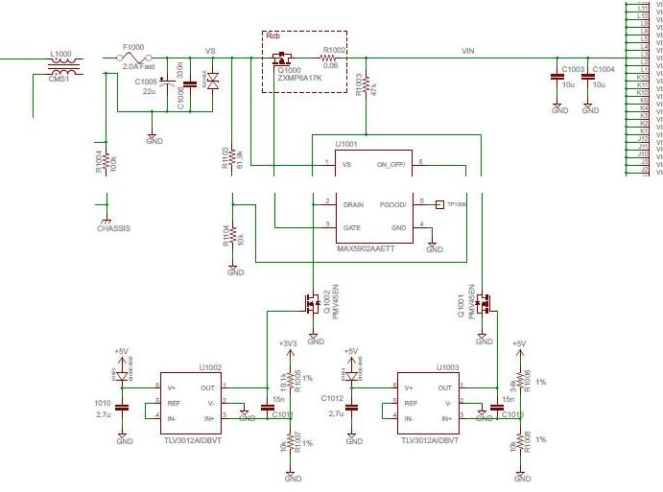
Switching Power Supply (cont…):
Power Bus input Choke
Common mode choke (balanced inductor). It is used as an EMI filter between the power bus and the SPS. he capstone 2006 value was chosen through a trial and error process from the previous LV2 SPS design. Each inductor of the choke is 100 uH.
Node Power Supply Fuse
This fuse protects the SPS from currents greater than 2000 mA. Its direct purpose however is to protect the power bus from a short circuit fault on the SPS side. Since the specified maximum SPS current is 2000 mA we chose a fuse rated at 2000 mA. The opening time for the fuse according to its datasheet is .05 s at a current of 8 A, or 5 s at 5 A. Currents of 2 A or below are 4 hours minimum, therefore this fuse will only protect the SPS or power bus from gross currents due to some fault on either side (power bus or SPS) and not to keep the SPS output current within spec, that is U1001's job

Slide 20
SPS
LTM4619 micro module
Vin = 4.5V ~ 26.4V
Iout = 4A
Output
5V, 500mA
3.3V, 2.2A
500kHz synchronized switching
80% efficiency
1.5% DC Voltage error

Slide 21
LTM4619

Slide 22
Frequency Divider (24MHz to 500KHz)

Slide 23
Protection
Over Current Protection at 1.6A
Under Voltage Lockout = 9V
Overvoltage Lockout at SPS-5V Bus = 5.45V
Overvoltage Lockout at SPS-3.3V Bus = 3.6V
Die temperature = +125ᵒC

Slide 24
Protection Circuitry

Slide 25
TQM5200:
Freescale PowerPC Processor MPC5200 up to 400MHz with MPC603e Processor Core
33MHz Oscillator for the CPU-Clock
Silicon Motion Graphic Controller SM501 with 8MB internal graphic memory
24MHz Oscillator for the Graphic Controller
SDRAM: 16MB up to 128MB1 / 256MB2; 32Bit data length
Flash: 4MB up to 32MB Flash3 Data length : 32Bit
SRAM: 512kByte or 1Mbyte, data length: 16-Bit. Possibility of buffering the battery by the Basis-Hardware
Serial EEPROM: 0kBit up to 64kBit, I2C-Bus
CPLD for Reset-Configuration and activation of SRAM and Graphic-Controller
Driver for two serial interfaces (RxD, TxD)
32-Bit Bus driver and 24-Bit Address Register for module components at the Local-Plus-Bus
COP/JTAG Interface
Single Power Supply 3.3V
Switch-Mode DC/DC Converter on the Module (3.3V on 1.5V)
Linear DC/DC Converter on the Module (3.3V on1.8V)
3.3V Supervisor/Power-Fail-Logic with SDRAM Battery Backup
240 Pin + 80Pin (320Pin) Board-to-Board connector system

Slide 26
TQM5200 (Cont…):
TQM5200 Connector
Two 40 pin connector :
Part Number: 179030-1
Connector Style = Plug
40 Positions
PCB Mount Angle = Vertical
Board-to-Board Stack Height = 7.00 mm, 11.00 mm, 15.00 mm, 19.00 mm
Two 120 pin connector :
Part Number: 179030-5
Connector Style = Plug
120 Positions
PCB Mount Angle = Vertical
Board-to-Board Stack Height = 7.00 mm, 11.00 mm, 15.00 mm, 19.00 mm
System Component:
CPU Main
MPC603e series G2_LE core
Superscalar architecture
760Mips at 400MHz (-40 to +85°C)
450Mips at 264MHz (-40 to +105°C)
16k Instruction cache, 16k Data cache
Double precision FPU
Instruction and Data MMU
Standard & Critical interrupt capability
SDRAM / DDR Memory Interface
up to 133MHz operation
SDRAM and DDR SDRAM support
256-MByte addressing range per CS, Two CS available
32-bit data bus
Built-in initialization and refresh
External Bus Interface
Supports interfacing to ROM/Flash/SRAM memories or other memory mapped devices
8 programmable Chip Selects
Non multiplexed data access using 8/16/32 bit data bus with up to 26 bit address
Short or Long Burst capable
Multiplexed data access using 8/16/32 bit data bus with up to 25 bit address
Peripheral Component Interconnect (PCI) Controller
Version 2.2 PCI compatibility
PCI initiator and target operation
32-bit PCI Address/Data bus
33 and 66 MHz operation
PCI arbitration function

Slide 27
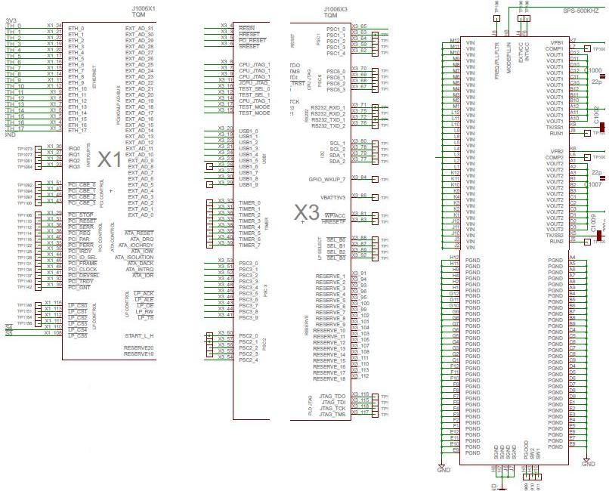
TQM5200 (Cont…):
ATA Controller
Version 4 ATA compatible external interface
6 Programmable Serial Controllers (PSC)
UART or RS232 interface
CODEC interface for Soft Modem, Master/Slave CODEC Mode, I2S and AC97
Full duplex SPI mode
IrDA mode from 2400 bps to 4 Mbps
Fast Ethernet Controller (FEC)
Supports 100Mbps IEEE 802.3 MII, 10Mbps IEEE 802.3 MII, 10Mbps 7-wire interface
Universal Serial Bus Controller (USB)
Version 1.1 Host only
Support for two independent USB slave ports
Two Inter-Integrated Circuit Interfaces (I2C)
Serial Peripheral Interface (SPI)
Dual CAN 2.0 A/B Controller (MSCAN)
Motorola Scalable Controller Area Network (MSCAN) architecture
Implementation of version 2.0A/B CAN protocol Standard and extended data frames

Slide 28
Testing:
Test Title | Condition | Expected Results
Under voltage on the Input | Assert VS node smaller than 9V | Q1000 MOSFET will be turned off in 4us.
Over Current on the Input | I > 1.62A (Assert current on VS node) | Q1000 will be turned off in 4us.
>>Over current disappear | I < 1.62A | over current event disappear after Q1000 turns off within 150 ms, then the normal start sequence is reinitiated.
Over voltage on SPS-5V output | Assert more than 5.46V on 5V bus | 1.)Q1001 will be turned on.
 |  | 2.)Q1000 will be turned off.
Over voltage on SPS-3V3 output | Assert more than 3.6V on 3V bus | 1.)Q1002 will be turned on.
 |  | 2.)Q1000 will be turned off.

Slide 29
Conclusion:
The initial requirements included a compact flash card connector for data storage. But after some early testing by the PSAS team, they found out the SBC had some trouble communicating with the CF at UDMA (which was the method of choice for data transfer.) So this required a change of plan and design. The presence of buffer between different modules on the STK and the main connectors made it difficult to run some pin testing on the board. The board was schedule to be a part of the LV2 launch sometimes in July but because of delay during the design process, that target was not reached.
Final Size of the Board – 4.6’’ x 3.84’’

Slide 30
References
http://www.memorydepot.com/ssd/listcat.asp?catid=EDC400044A
http://www.mini-box.com/4GB-40-pin-Embedded-Disk-Card-4000

